Slide 1


Development of Heavily Aluminized Solid Rocket Propellant
Ruby Gomez (Presenter)
Gaines Gibson

Slide 2
Outline
Daedalus Astronautics at ASU
Project Purpose
Chemical Properties
Mixing Procedures
Testing Equipment
Testing Results and Analysis

Slide 3

Daedalus Astronautics
Student Organization at Arizona State University
Extensive Propulsion Experience
Community involvement

Slide 4

Project Purpose
To develop a heavily aluminized solid rocket propellant
To characterize the new propellant
“Characterize” in using rocket design equations, simulation, and empirical testing on the new solid propellant
To test propellant on conventional (delavel) and multi-grid nozzle
funded project

Slide 5
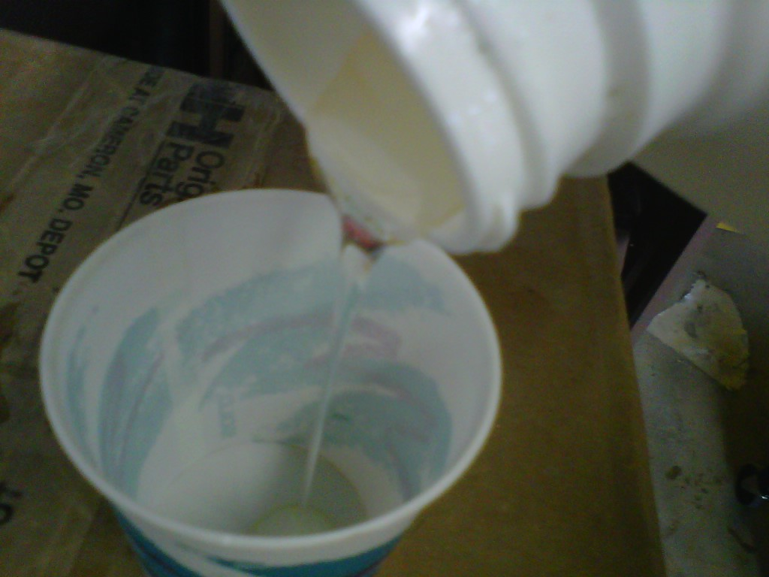
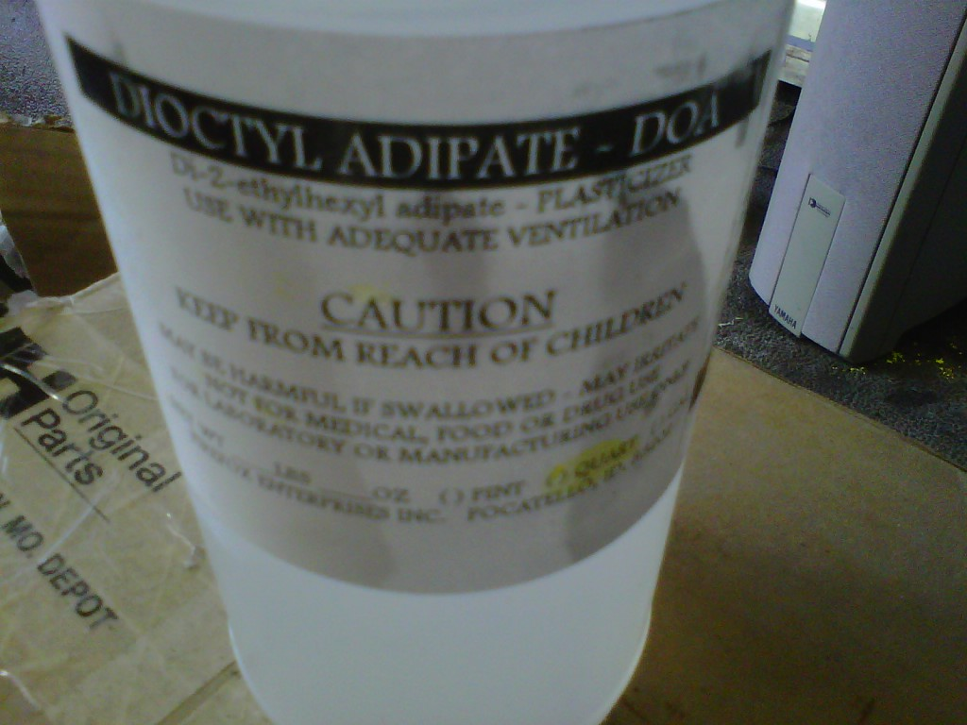
Chemical Properties
Liquids
HTPB (Hydroxyl-terminated-polybutadiene) similar color to wax paper, highly viscous, and a binder (to bind the fuel (aluminum) and oxidizer (ammonium perchlorate))
DOA (Dioctyl Adipate) - light colored oil used as plasticizer (to reduce viscosity of propellant)

Slide 6
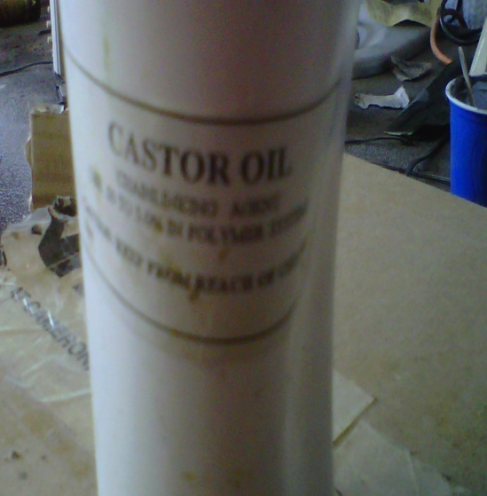
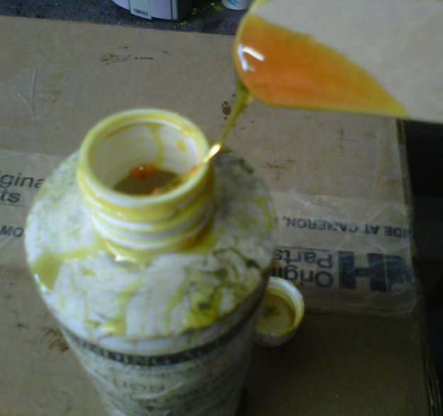
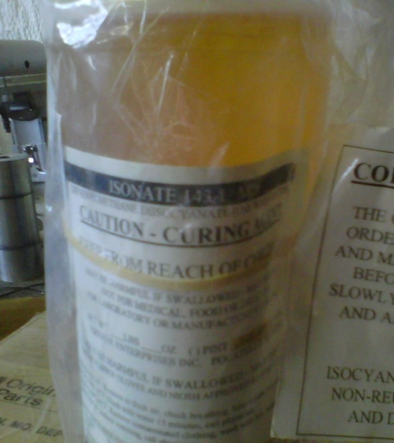
Chemical Properties
Liquids
Castor oil – very pale yellow liquid used to harden the grains, to prevent fractures and increase the density
Tepanol – is a very sticky substance used as a bonding agent to strengthen the bond between the binder (HTPB) and oxidizer (ammonium perchlorate)
Isonate 143L – is the curative which starts the processing of hardening the solid propellant
Curing Agent

Slide 7
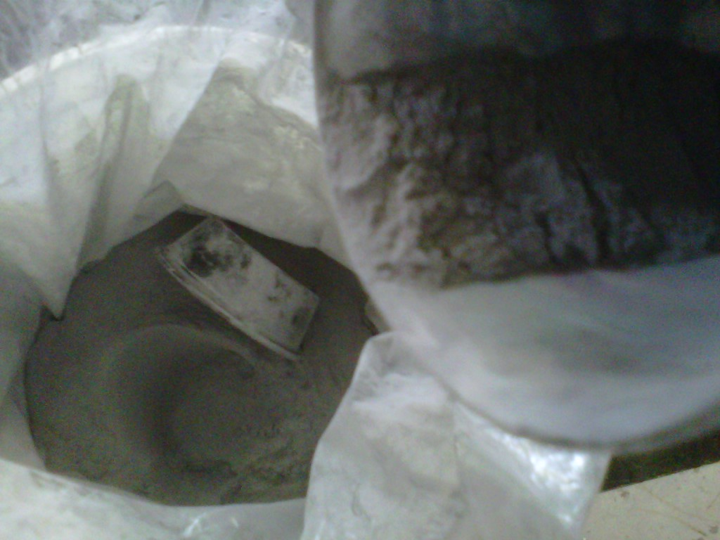
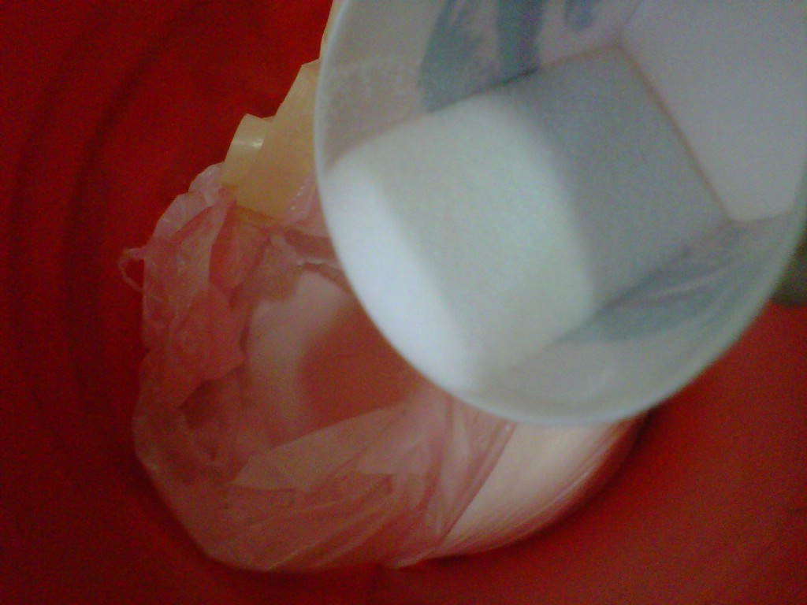
Chemical Properties
Fuel
Oxidizer
Aluminum – used as a fuel in powder form 325 mesh
Ammonium Perchlorate – is the oxidizer

Slide 8
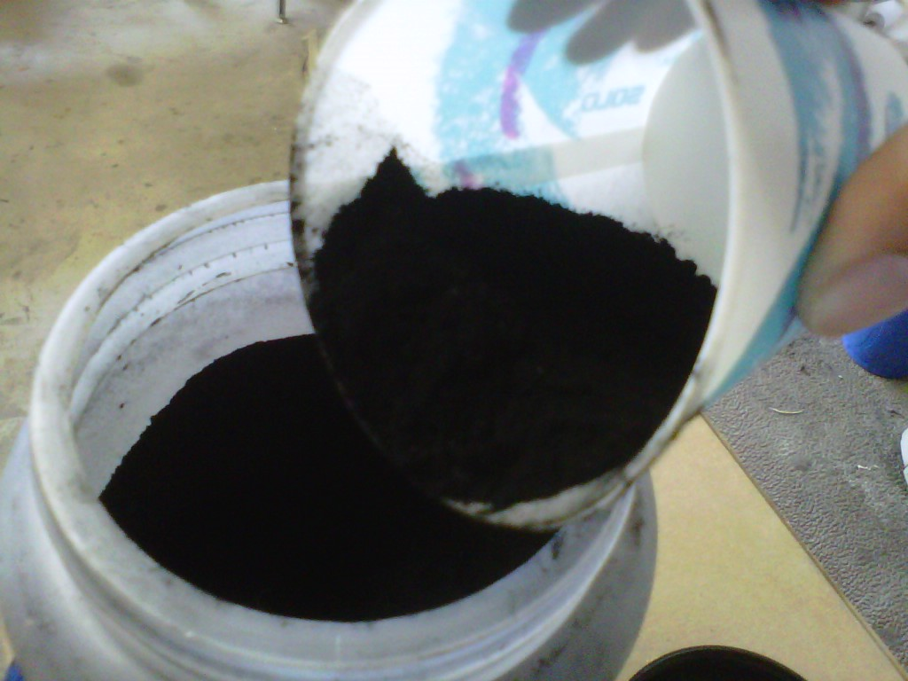
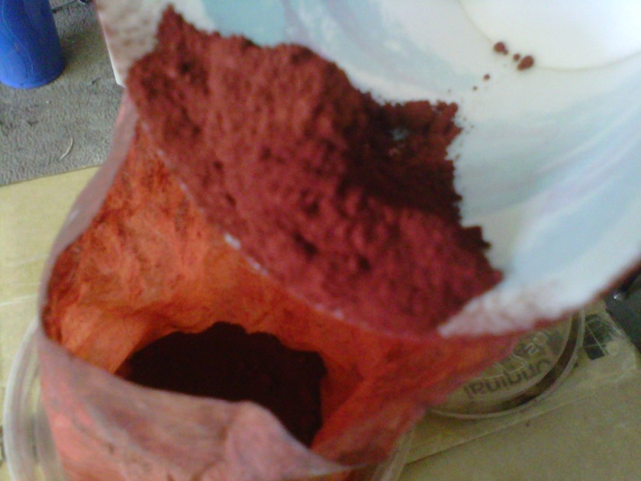
Chemical Properties
Solids
Carbon black – a dyeing agent , prevents the grains from breaking down due to the ultraviolet light released during combustion
Ferric (Iron III) oxide - creates thermite reaction, serves as a catalyst to the combustion reaction

Slide 9
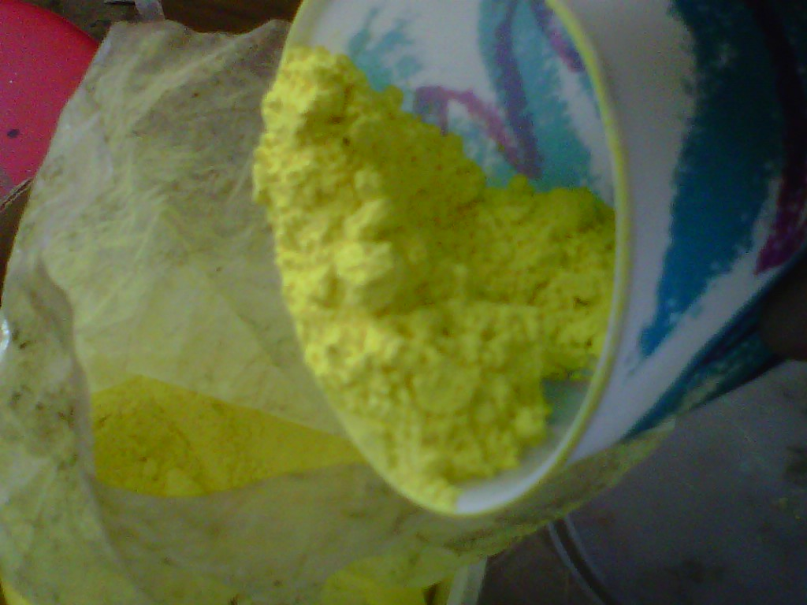
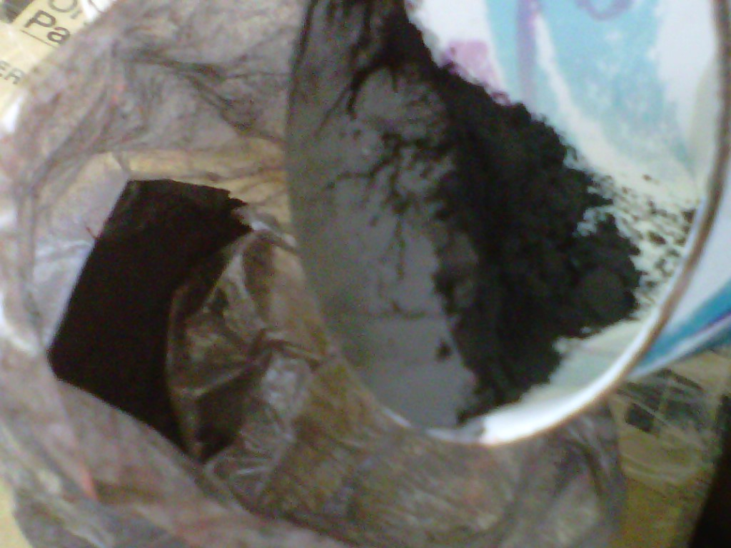
Chemical Properties
Solids
Strontium chromate – very powerful oxidizer
Copper II oxide- creates thermite reaction, serves as a catalyst to the combustion reaction

Slide 10
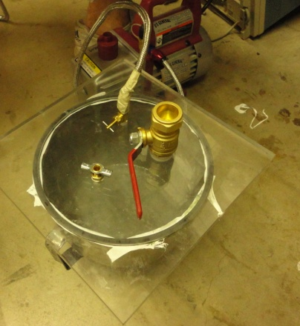
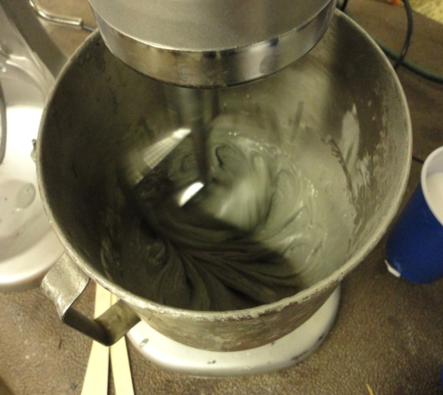
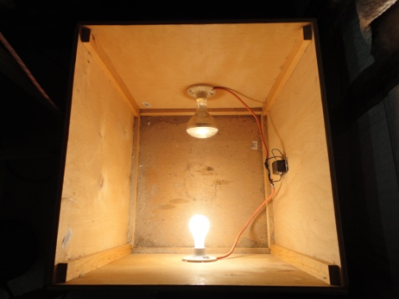
Mixing Procedures
Liquids – HTPB, DOA, CO, TP
Fuel – aluminum
Vacuum
Solids – CB, FO, SC, C3O
Oxidizer – ammonium perchlorate
Curing Agent – Isonate 143L
Cast
Heat Treatment
Custom made Vacuum plate
Kitchen Aid mixture
Custom made Heat Box

Slide 11
Raytheon Propellant Formulation
Order | Material | Purpose / Component | Percentage | Calculated Weight (lb)
1 | HTPB | Binder | 8.5 | 0.64425
2 | Aluminum | Fuel | 19 | 1.425
3 | DOA | Plasticizer | 2 | 0.15
4 | HX-752 | Bonding Agent | 0.3 | 0.0225
5 | Tepanol | Bonding Agent | 0.5 | 0.0375
6 | Ammonium Perchlorate (AP) | Oxidizer | 69 | 5.175
7 | IPDI | Curative | 0.59 | 0.04425
N/A | TPB | N/A | 0.02 | -

Slide 12
Daedalus Propellant
 | Original CrazyPants3 Formulation | CrazyPants3 Modification 1 | CrazyPants3 Modification 2
Chemical | Percentage | Percentage | Percentage
Ammonium Perchlorate (200 micron) | 73.8 | 72.3 | 70.96
HTPB | 14.2 | 13.9 | 13.65
Aluminum (325 mesh) | 5 | 7 | 9
Dioctyl Adipate | 3.55 | 3.48 | 3.41
Isonate 143L | 1.84 | 1.80 | 1.77
Iron Oxide | 0.55 | 0.54 | 0.529
Strontium Chromate | 0.30 | 0.29 | 0.288
Carbon Black | 0.20 | 0.196 | 0.192
Tepanol | 0.20 | 0.196 | 0.192
Castor Oil | 0.20 | 0.196 | 0.192
Copper Oxide | 0.15 | 0.147 | 0.144
Silicon Oil | 0.01 | 0.009 | 0.009

Slide 13
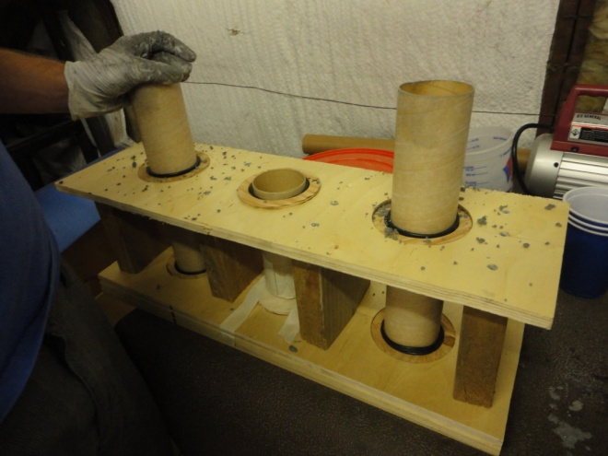
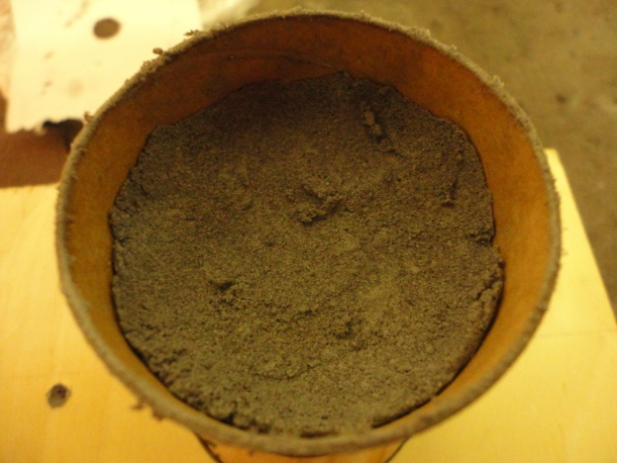
Mixing Difficulties
Tepanol and Ammonium production
Texture of Heavily Aluminize Propellant
Hardening
Custom built casting rack
Casted grain

Slide 14
Testing Equipment

Slide 15
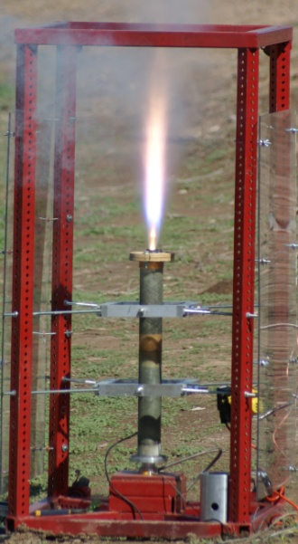
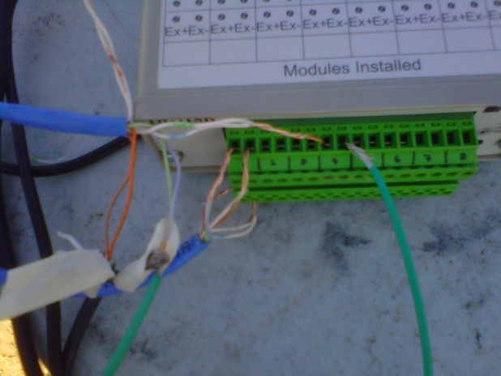
Testing Equipment
Data Acquisition (DAQ) model 718B – records pressure and thrust data
Test Stand – custom built test stand

Slide 16

Test One
Test one failure analysis
Root cause analysis found failure due to nozzle throat area
Extremely aggressive propellant burn
Summary
Original CP-3 Propellant
Result: Catastrophic over-pressurization

Slide 17
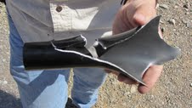
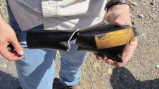
Test Two
Test two failure analysis
Root cause was extremely fast regression rate
Exact same hoop stress failure as first test
Summary
7% CP-3 Propellant
Result: Catastrophic over-pressurization
60 lb thrust at operating pressure

Slide 18

Special Thanks
Matt Summers

Slide 19
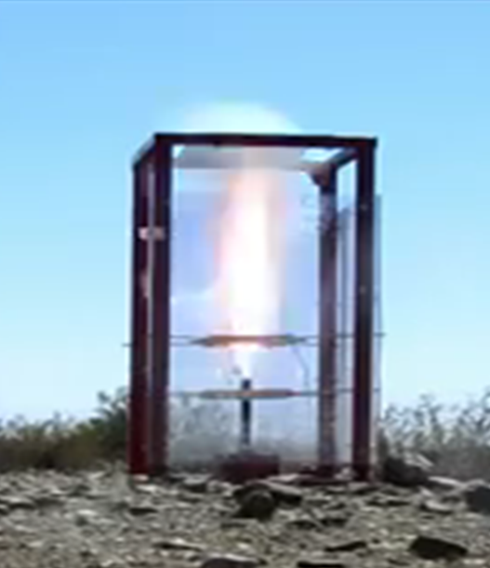
Questions

